Slide 1
Introduction to Data Visualization
Jeremy Morris
Department of Operations and Information Systems
University of Utah

Slide 2
Agenda
The importance of Data Visualization (DV)
History of DV
Hierarchy of priorities
The basics of DV
Delivery methods
Types
Examples
Process
Encoding
Notes:
Course is setup so that we talk quite a bit about how to design an individual visualization and then work our way to ttelling data stories at the end
We also discuss the difference between exploratory and explanatory analysis
Due to some time constraints, we can’t get into the particulars of some of these topics. I’ll do my best to offer tips along the way.

Slide 3
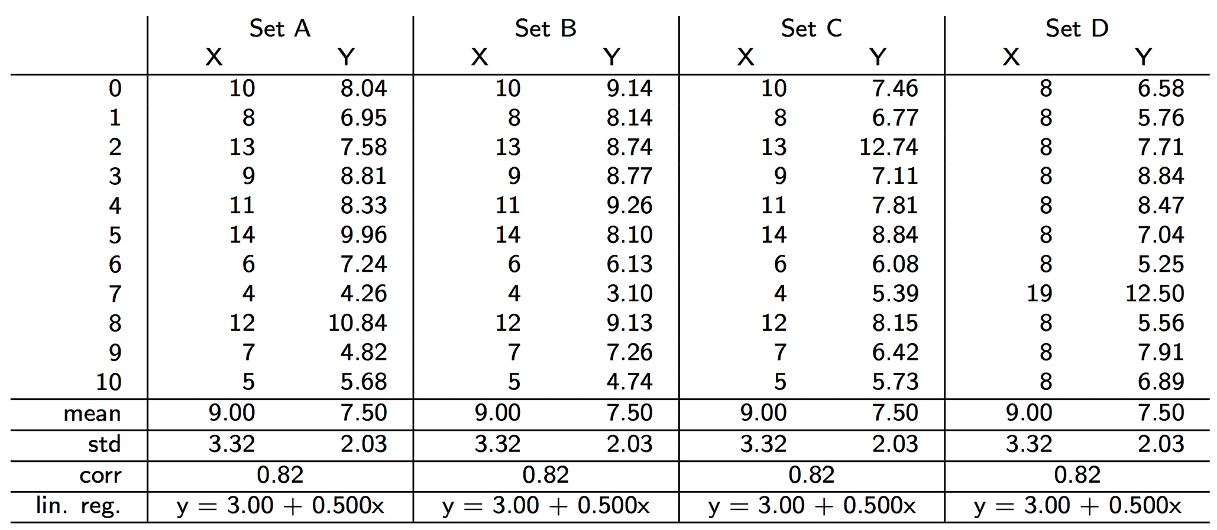
The importance of Data Visualization | Anscombe’s Quartet*
* http://cs.wheatonma.edu/mgousie/comp401/anscombe_table.jpg, accessed 2016-06-20
Notes:
Anscombe’s quartet is a great example of the power of data visualization. There are varying levels of analysis that would be completed by analysts like yourself (students).
Does anything stand out about this dataset? (Similar statistical properties, mean, std, corr, lin.reg)
This is often where first year analysts go with their analysis. The will pull out the basic statistical properties, and create a table for presentation to the team. However, nothing about this table is easy to consume. As analysts we have to put a lot of mental effort into drawing out insights from data in this format. What are we missing when looking at this data set.
Anscombe’s quartet is four datasets that have similar statistical properties
Constructed in 1973 by statistician Fancis Anscombe, each dataset contains all points.
Importance of graphing before analysis (and the impact of outliers)

Slide 4
Anscombe’s Quartet | visualization*
* https://en.wikipedia.org/wiki/Frank_Anscombe, accessed 2016-06-20

Slide 5
Datasaurus Dozen
Credit: Alberto Cairo, data downloadable here

Slide 6
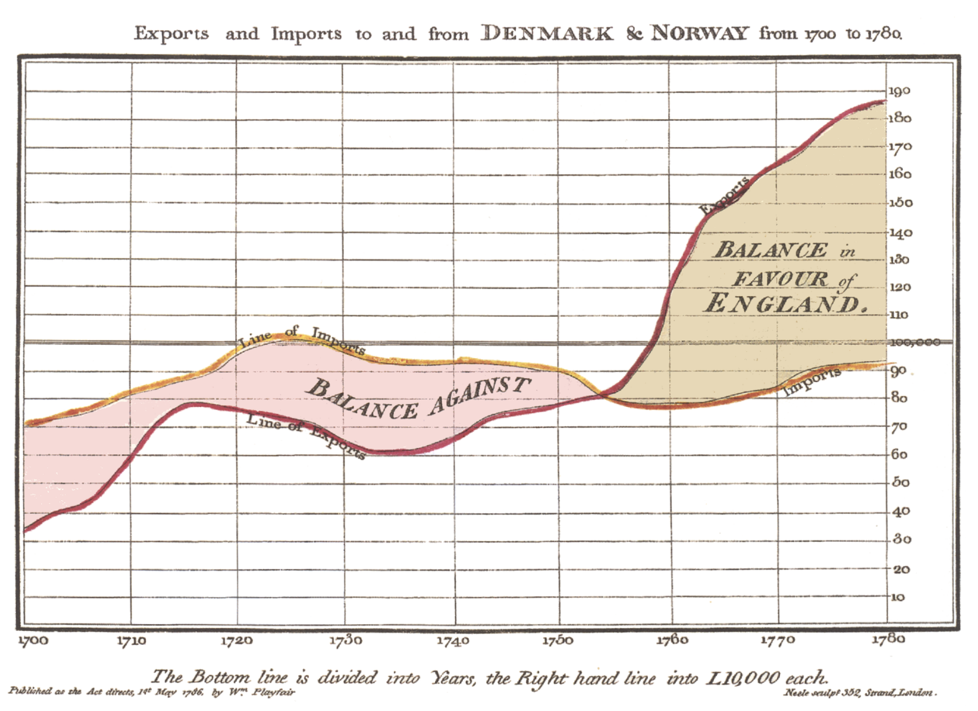
History of Data Visualization
William Playfair: credited for inventing
Line chart
Area chart
Bar Chart
Pie Chart
Most elements used in contemporary visualizations are shown here:
Axis
Use of color
Gridlines
Label
The Commercial and Political Atlas (1786)

Slide 7
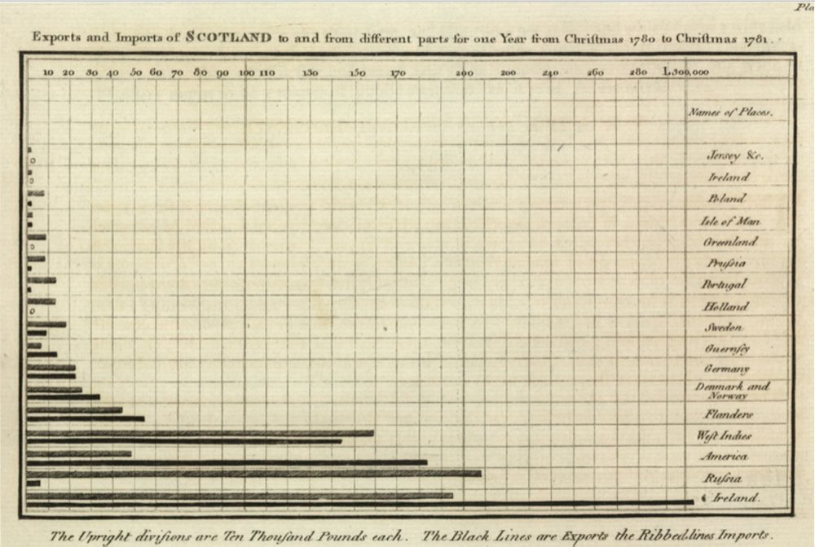
History of Data Visualization (cont’d)
Playfair (1786): a lack of data led to the the invention of the Bar Chart

Slide 8
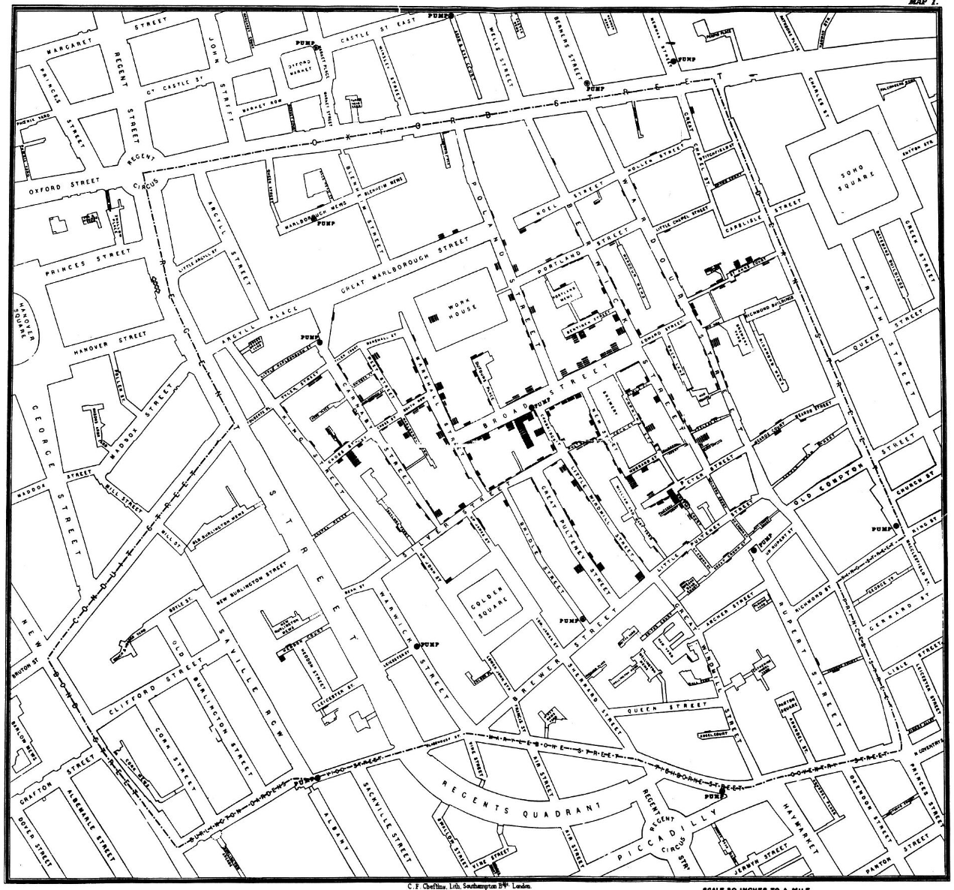
The 1854 Broad Street cholera outbreak*
On 31 August 1854, a major outbreak of cholera occurred in Soho (London, England)
By the end of the outbreak, 616 people had died
John Snow (physician) was skeptical of dominant theory that the disease was airborne
Plotted locations of cholera cases
Central to the (scatter) plot was a public water pump (the source of the spread of the disease)
* https://en.wikipedia.org/wiki/1854_Broad_Street_cholera_outbreak, accesed, 2016-06-20

Slide 10
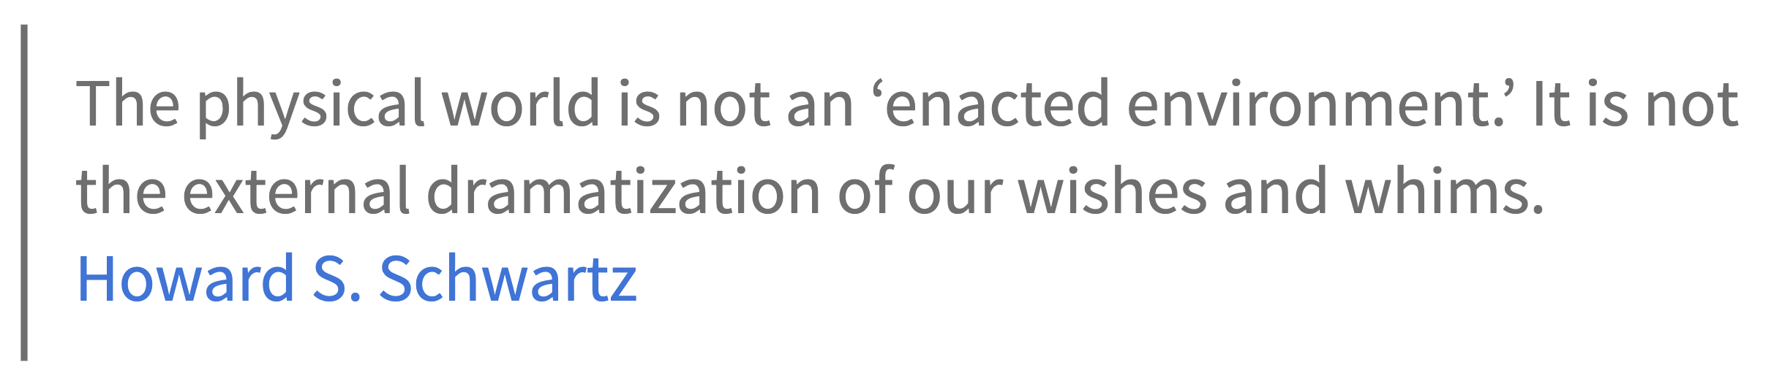
Why do we analyze data?

Slide 11

How does it work?
Notes:
What is the reason we do data visualizations? – broad question, but

Slide 12
Exploration Leads to Explanation
1) Some Data Set
3) Insights
2) Exploratory Analysis
5) Data Visualization
4) Explanatory Analysis and Design
Notes:
Mental model some people have
Is it right?

Slide 13
How it should work
1) Context
2) Objectives
5) Data Visualization
3) Hypotheses
4) Exploratory Analysis

Slide 14
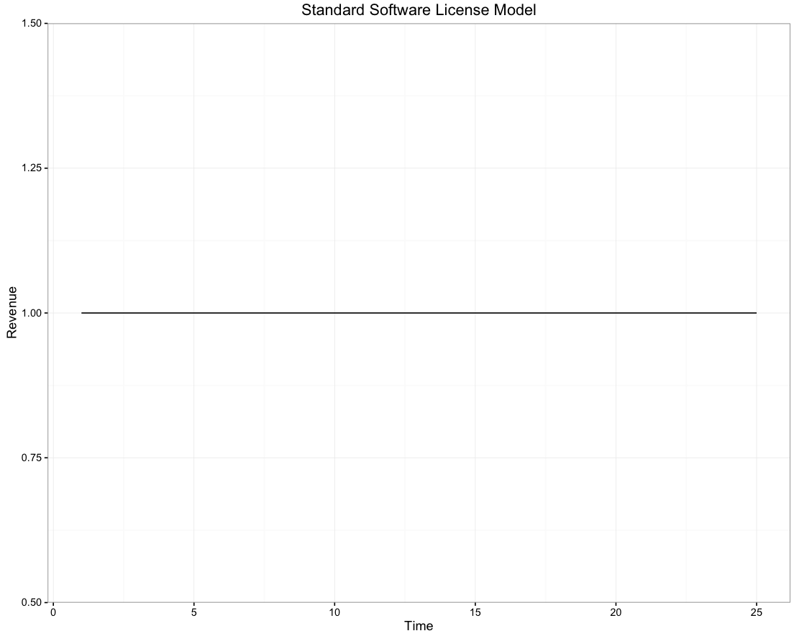
Assume we own a software company.
We sell one new customer every year.
Our product costs $1

Slide 15
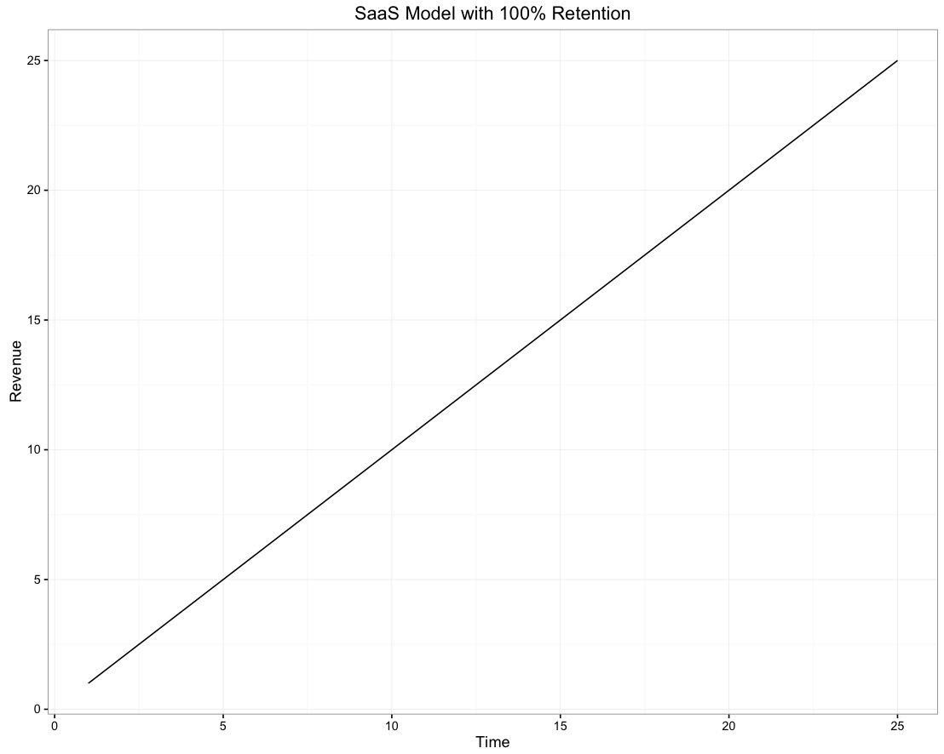
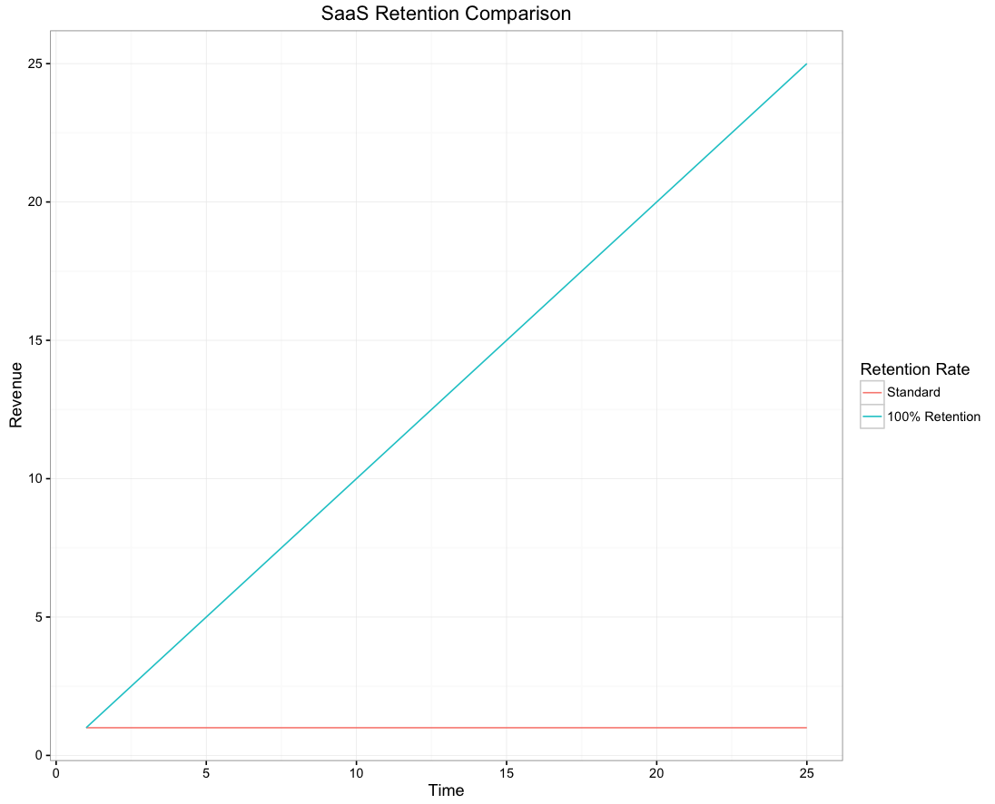
What if we’re a SaaS company?

Slide 16
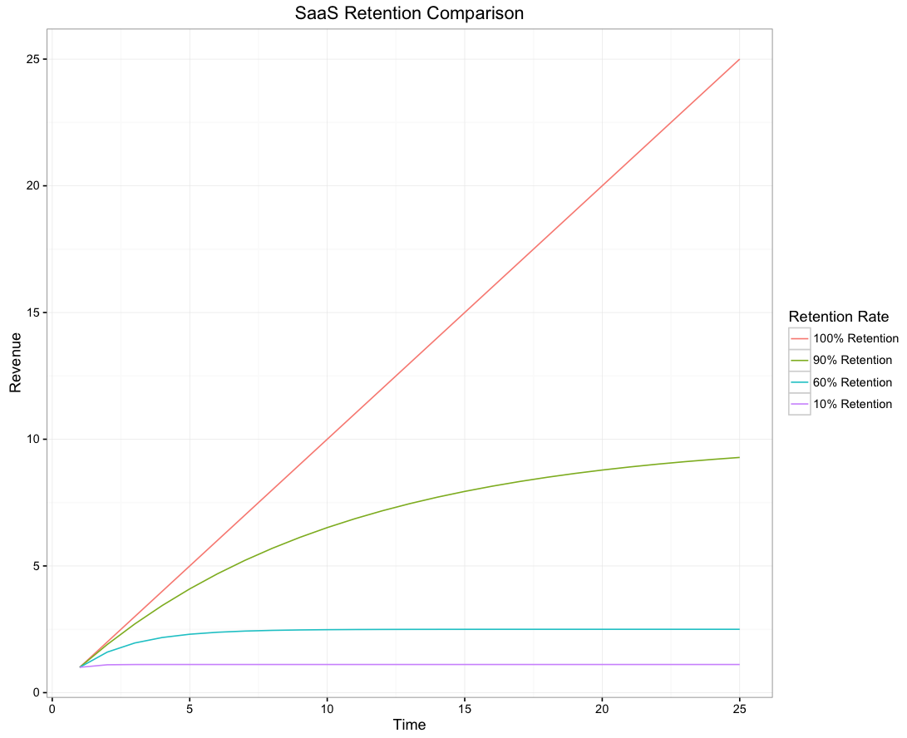
What if we’re not perfect?

Slide 17
Things to consider
Who
Consider carefully your audience.
Your relationship with the audience could have a large impact on your work.
What
What do you want your audience to do?
How
Creating data visualizations that help make and support your point.
What do you need them to know?
Notes:
Has anyone ever produced a data visualization for someone other than yourself (or a professor) and how did it go?

Slide 18
Detail – Who
Your Audience
Be as specific as possible
Avoid general audiences, “internal and external stakeholders”
Trying to communicate to too many different people will be less effective
The more you know about them (what they care about, what they can do) the better
You
Think through the relationship you have with your audience
Is this your first meeting or do you have an established relationship?
This will help you structure your communication and may impact the flow/order
Notes:
Thinking about our group presentations, you may have to fabricate the relationship you have. on the other hand, it can be helpful to think if there’s anything you could work on for this project.

Slide 19
Detail – What
Action
What the audience needs to know or do
If you don’t have a concise action, consider if you need to communicate at all
Feel confident suggesting action
Asking for action leads to more productive conversations (even if your suggestion is not taken)
Mechanism
How will you communicate with your audience?
Will there be a live presentation or not?
Live presentation provides the most control
Written document or email the least
Tone
Tone is the attitude you take to the given subject
Celebrating success?
Driving action?
Lighthearted or serious?
Should never be overly negative
Notes:
Thinking about our group presentations, you may have to fabricate the relationship you have. on the other hand, it can be helpful to think if there’s anything you could work on for this project.

Slide 20
Delivery method
Powerpoint
Email
Blog post
Dashboard
Why?
What does it do best?
What does it do best?
Why?
Why?
What does it do best?
Why?
What does it do best?
Notes:
More and more, we’re seeing the delivery of dynamic visualizations. Which of these could be dynamic? In what situations do you want it to be dynamic and which do you not want it dynamic?

Slide 21
Detail – how
What data do we need to answer these questions?
What data is available?
What methods do we need to use?

Slide 22
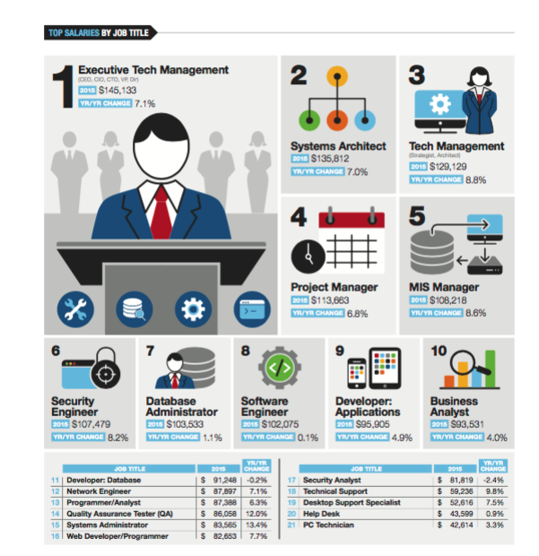
Infographic | example
http://marketing.dice.com/pdf/Dice_TechSalarySurvey_2016.pdf, accessed 2016-06-20

Slide 23
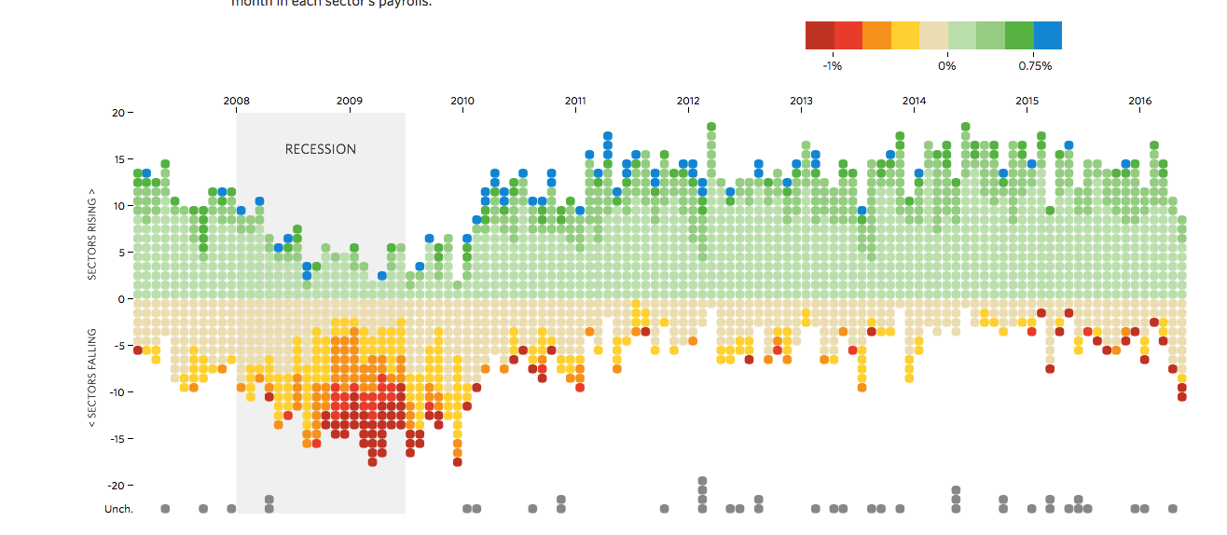
Data Visualization | example
Navigate to: http://graphics.wsj.com/job-market-tracker/
Discussion:
What is this:
Effective for?
Not so effective for?
Notes:
Why is this a data visualization?
Critique
The point is, I think we know what is effective and what isn’t. also, it is so context dependent. In this class we’ll learn how to fix things like this.

Slide 24
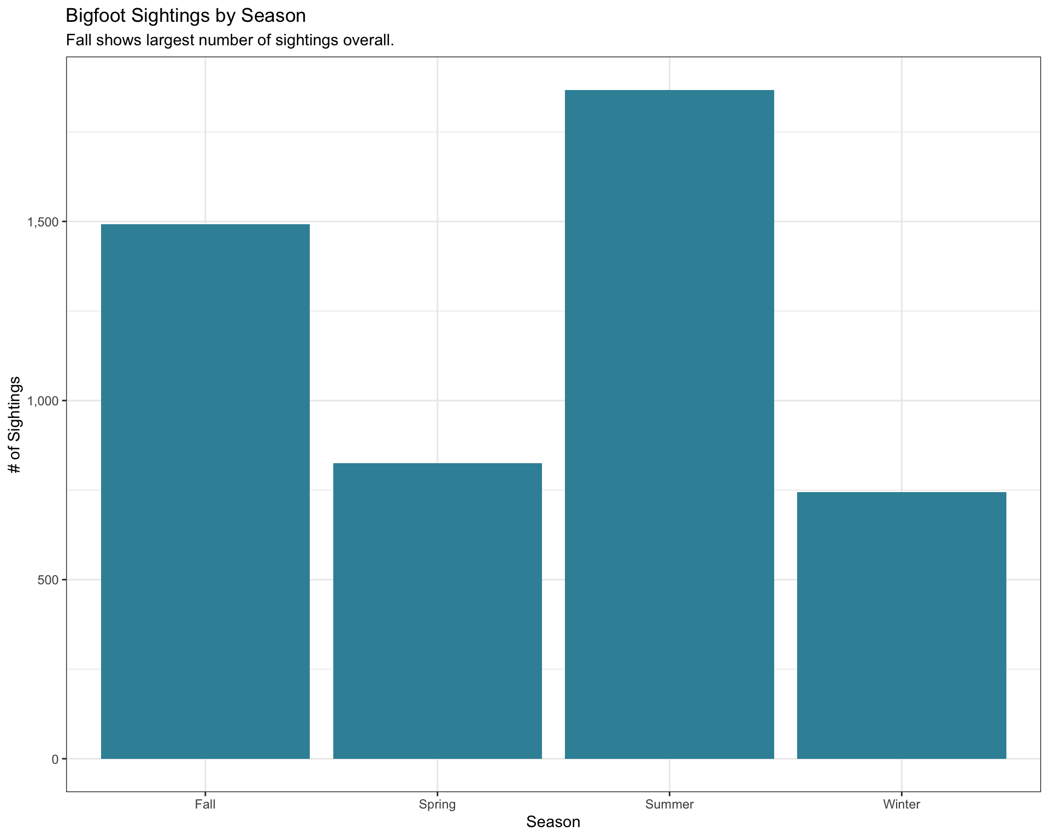
Data visualization | Example
Generated by the ggplot library in R
System created for analyzing data
Series of commands that generate the chart

Slide 25
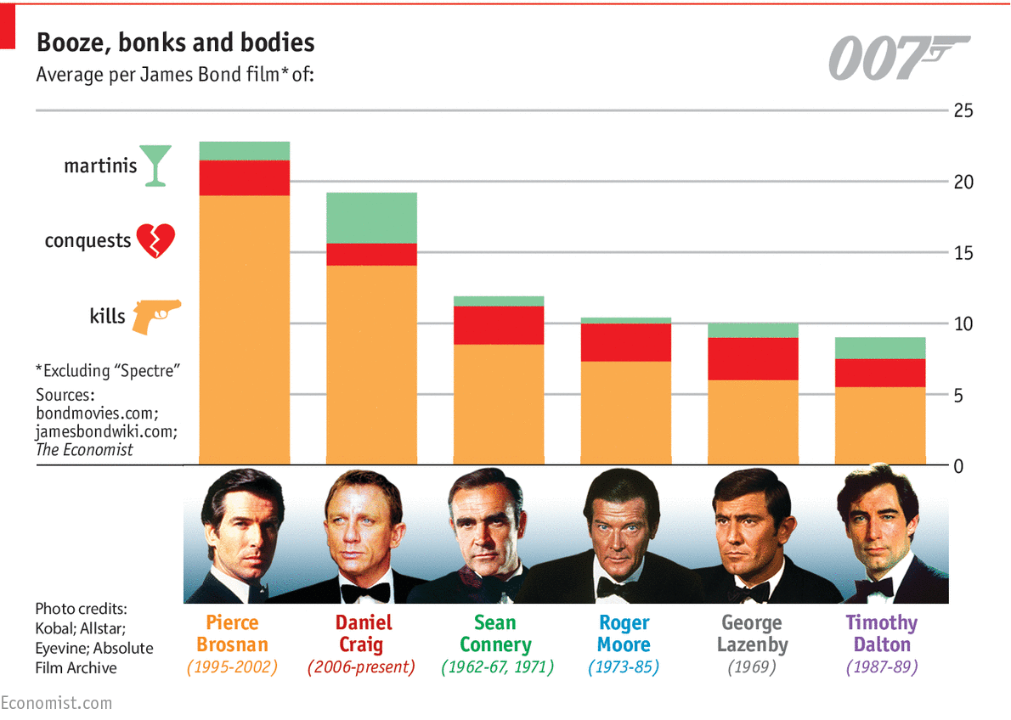
Hybrid (infographic + data visualization) | example
Discussion:
Which parts are:
Manually created?
Automatically created?

Slide 26
Explanatory Analysis | example
The beauty of data visualization - David McCandless
https://www.youtube.com/watch?v=5Zg-C8AAIGg
Start: Beginning
End: 2:26

Slide 27
The data visualization process
Nussbaumer
Illinsky, Noah
Understand the context
Choose an appropriate display
Eliminate clutter
Draw attention where you want it
Think like a designer
Tell a story
Phase 1: What to vizualize
Consider your inputs
Consider your (Designer) goals
Consider their needs (Reader)
Consider the data properties
Write a spec for the vizualization; e.g. "Show the relationship between A and B [and C...] across X [and Y...] from m to n in order to determine our best and worst performing widgets.”
Select data to include
Phase 2: How to vizualize
Select axes for most important data/relationship
Consider defaults and best encodings for all other data
Experiment/iterate

Slide 28
Why DV works
Visualizations leverage our brains’ pattern recognition abilities to quickly identify items of note, reducing cognitive strain

Slide 29
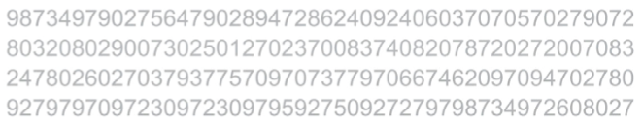
Why DV works | exercise (part 1)
Count the 5’s:

Slide 30
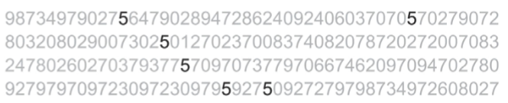
Why DV works | exercise (part 2)
Count the 5’s:

Slide 31
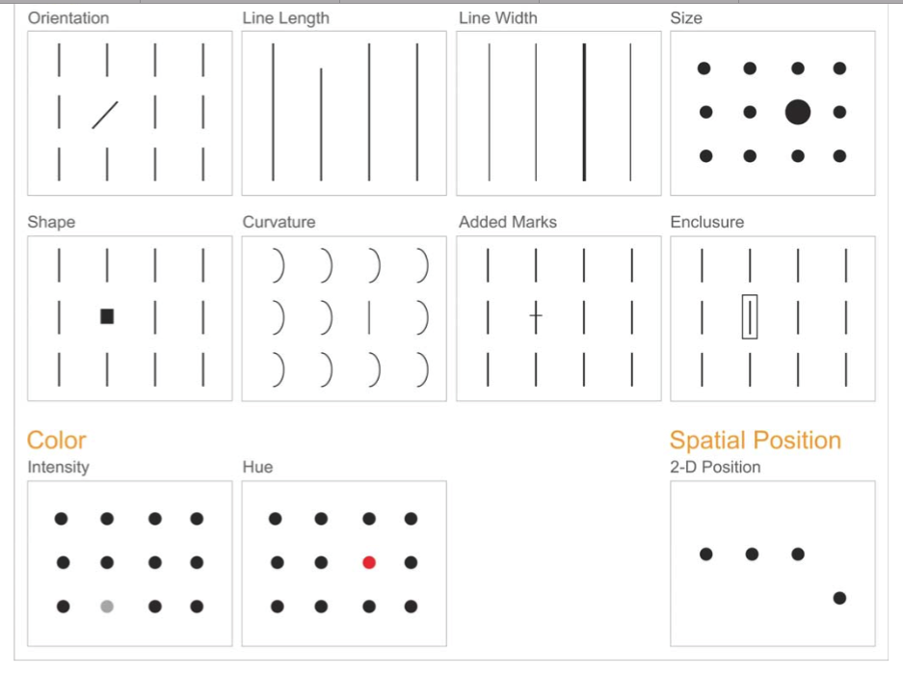
Preattentive Attributes
Can be used to:
Focus your audience’s attention
Create a visual hierachy of elements to lead yoru audience through the information in the way you want them to process it
* https://www.perceptualedge.com/articles/ie/visual_perception.pdf, accesed, 2016-06-20
Notes:
Use to direct audience

Slide 32
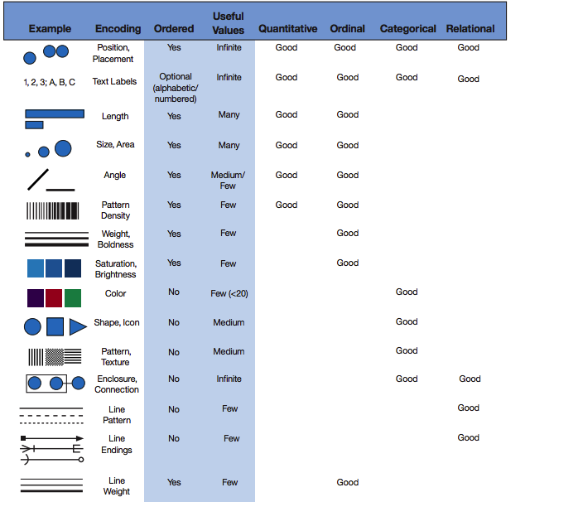
Data Encodings
* http://complexdiagrams.com/properties , accesed, 2017-11-16
Notes:
Data encodings can help effectively show relationships
Use the table to decide how to encode or visualize our data
Use color as an example, no order so use accordingly
color used a lot b/c attractive but may not be effective given what you want to do
Want to make sure we do what is effective, and not necessarily what is attractive

Slide 33
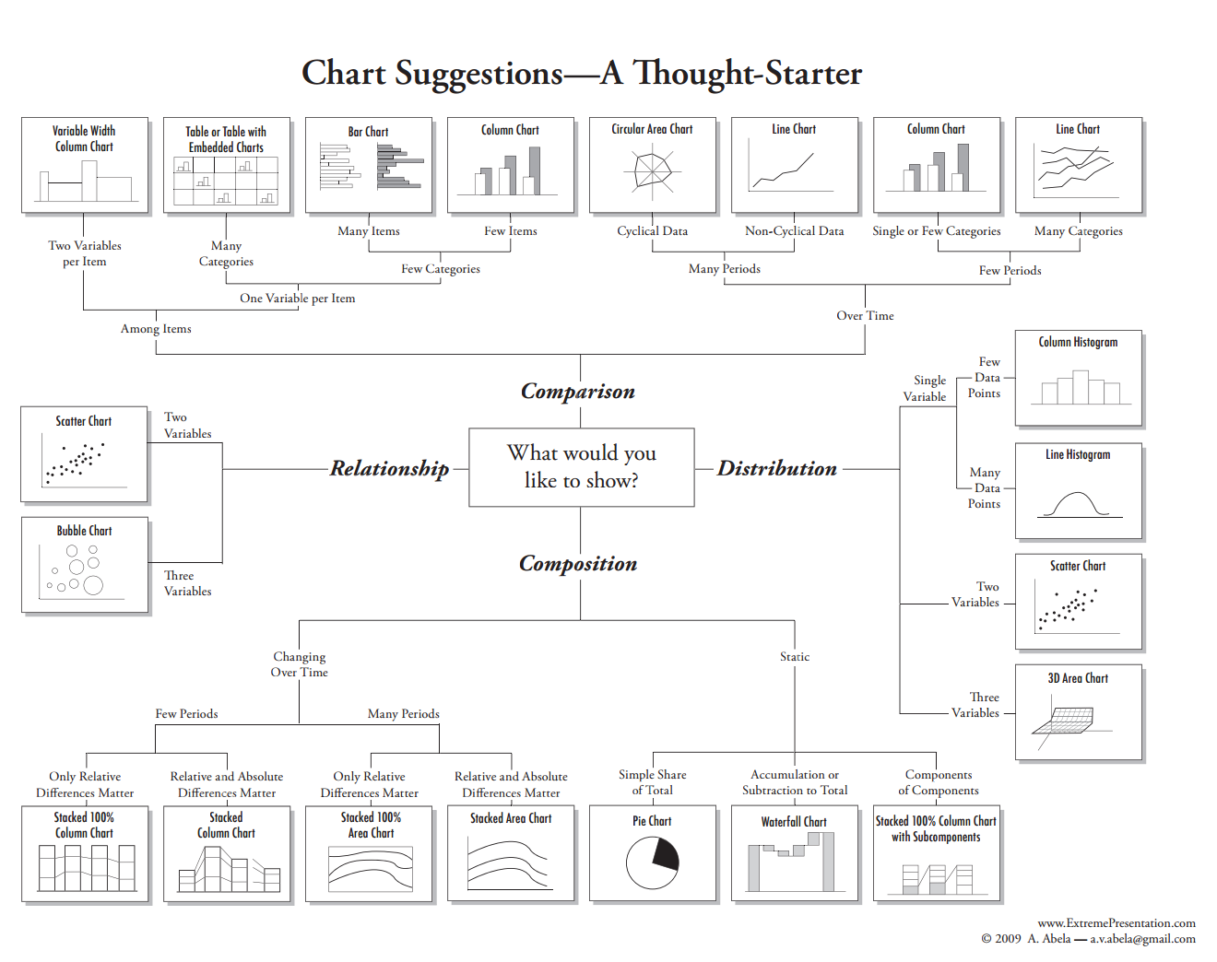
Choosing an appropriate display
* http://extremepresentation.typepad.com/blog/2006/09/choosing_a_good.html, accessed, 2016-06-20
Notes:
http://extremepresentation.typepad.com/blog/2006/09/choosing_a_good.html

Slide 34
Appendix

Slide 35
Intro to programming/scripting
Programming Language – a set of instructions or commands that a computer can execute.
There are different flavors that focus on different things.
At the core, they all do the same things.
Read/store/write data (including other kinds of output
Math
Logic (including conditional statements)
Repeat commands (looping)

Slide 36
Intro to R
R released for the first time in 1995
based off the S programming language
Built specifically for statistics and data visualization
Benefits
Extensible by user-contributed packages
Native matrix operations
Flexible data types
Cons
Syntax is a little weird
Lots of packages!?!?
Flexible data types

